Slide 1
冒險故事
112598088 何柏憲
Notes:
大家好，接下來我會跟大家說一個有關於我的故事

Slide 2
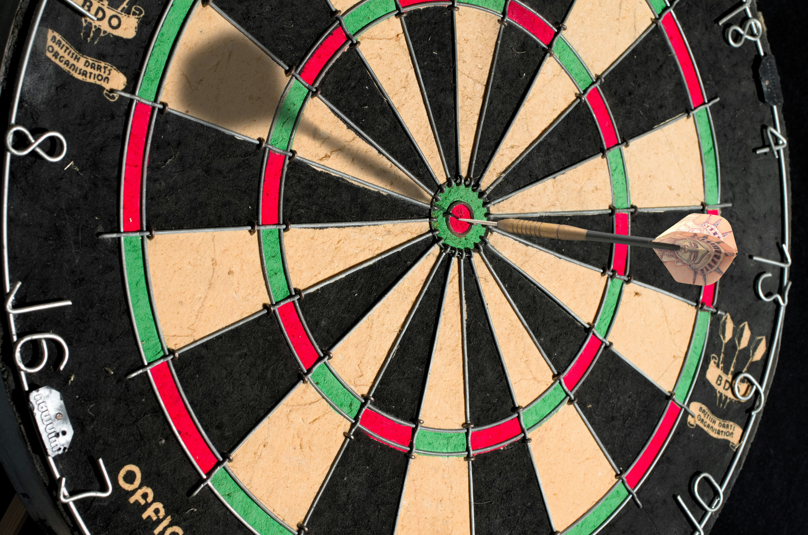
1.目標
Notes:
https://unsplash.com/photos/brown-and-black-round-board-DX3_dXuHVl8

Slide 3
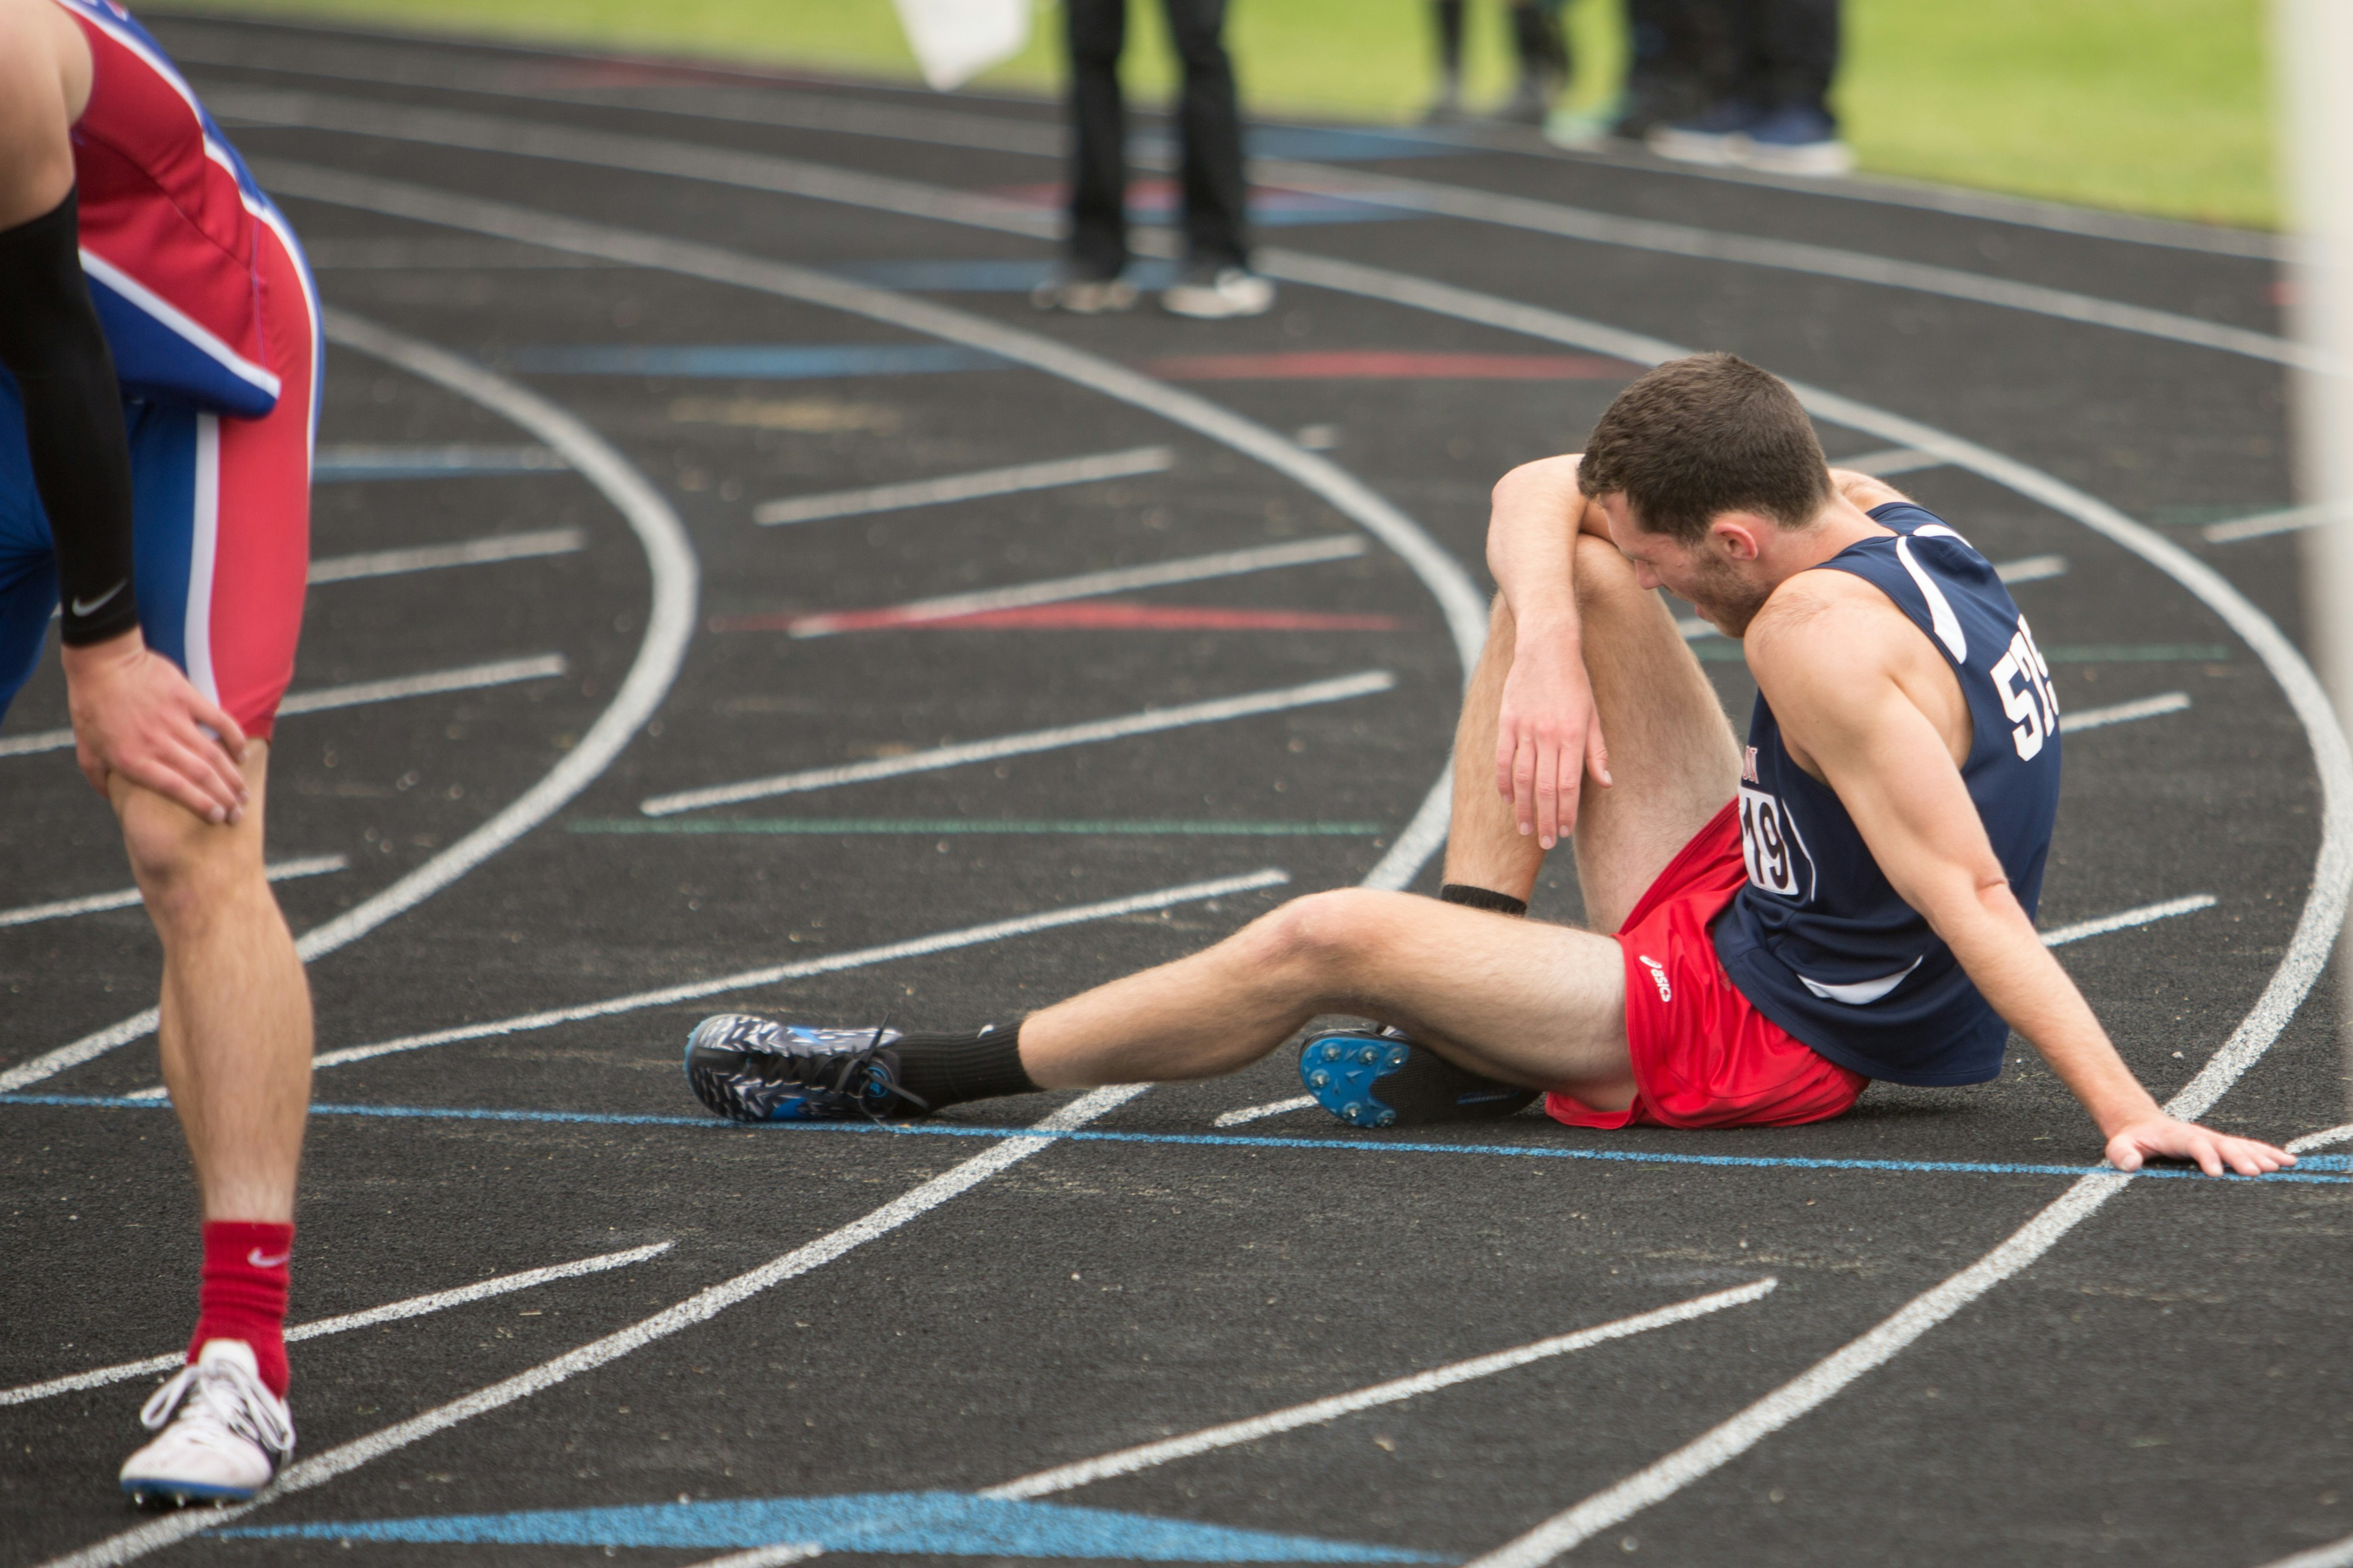
2.阻礙
Notes:
Tired
https://unsplash.com/photos/a-man-sitting-on-the-ground-in-a-track-OHmYjiiaOvs

Slide 4
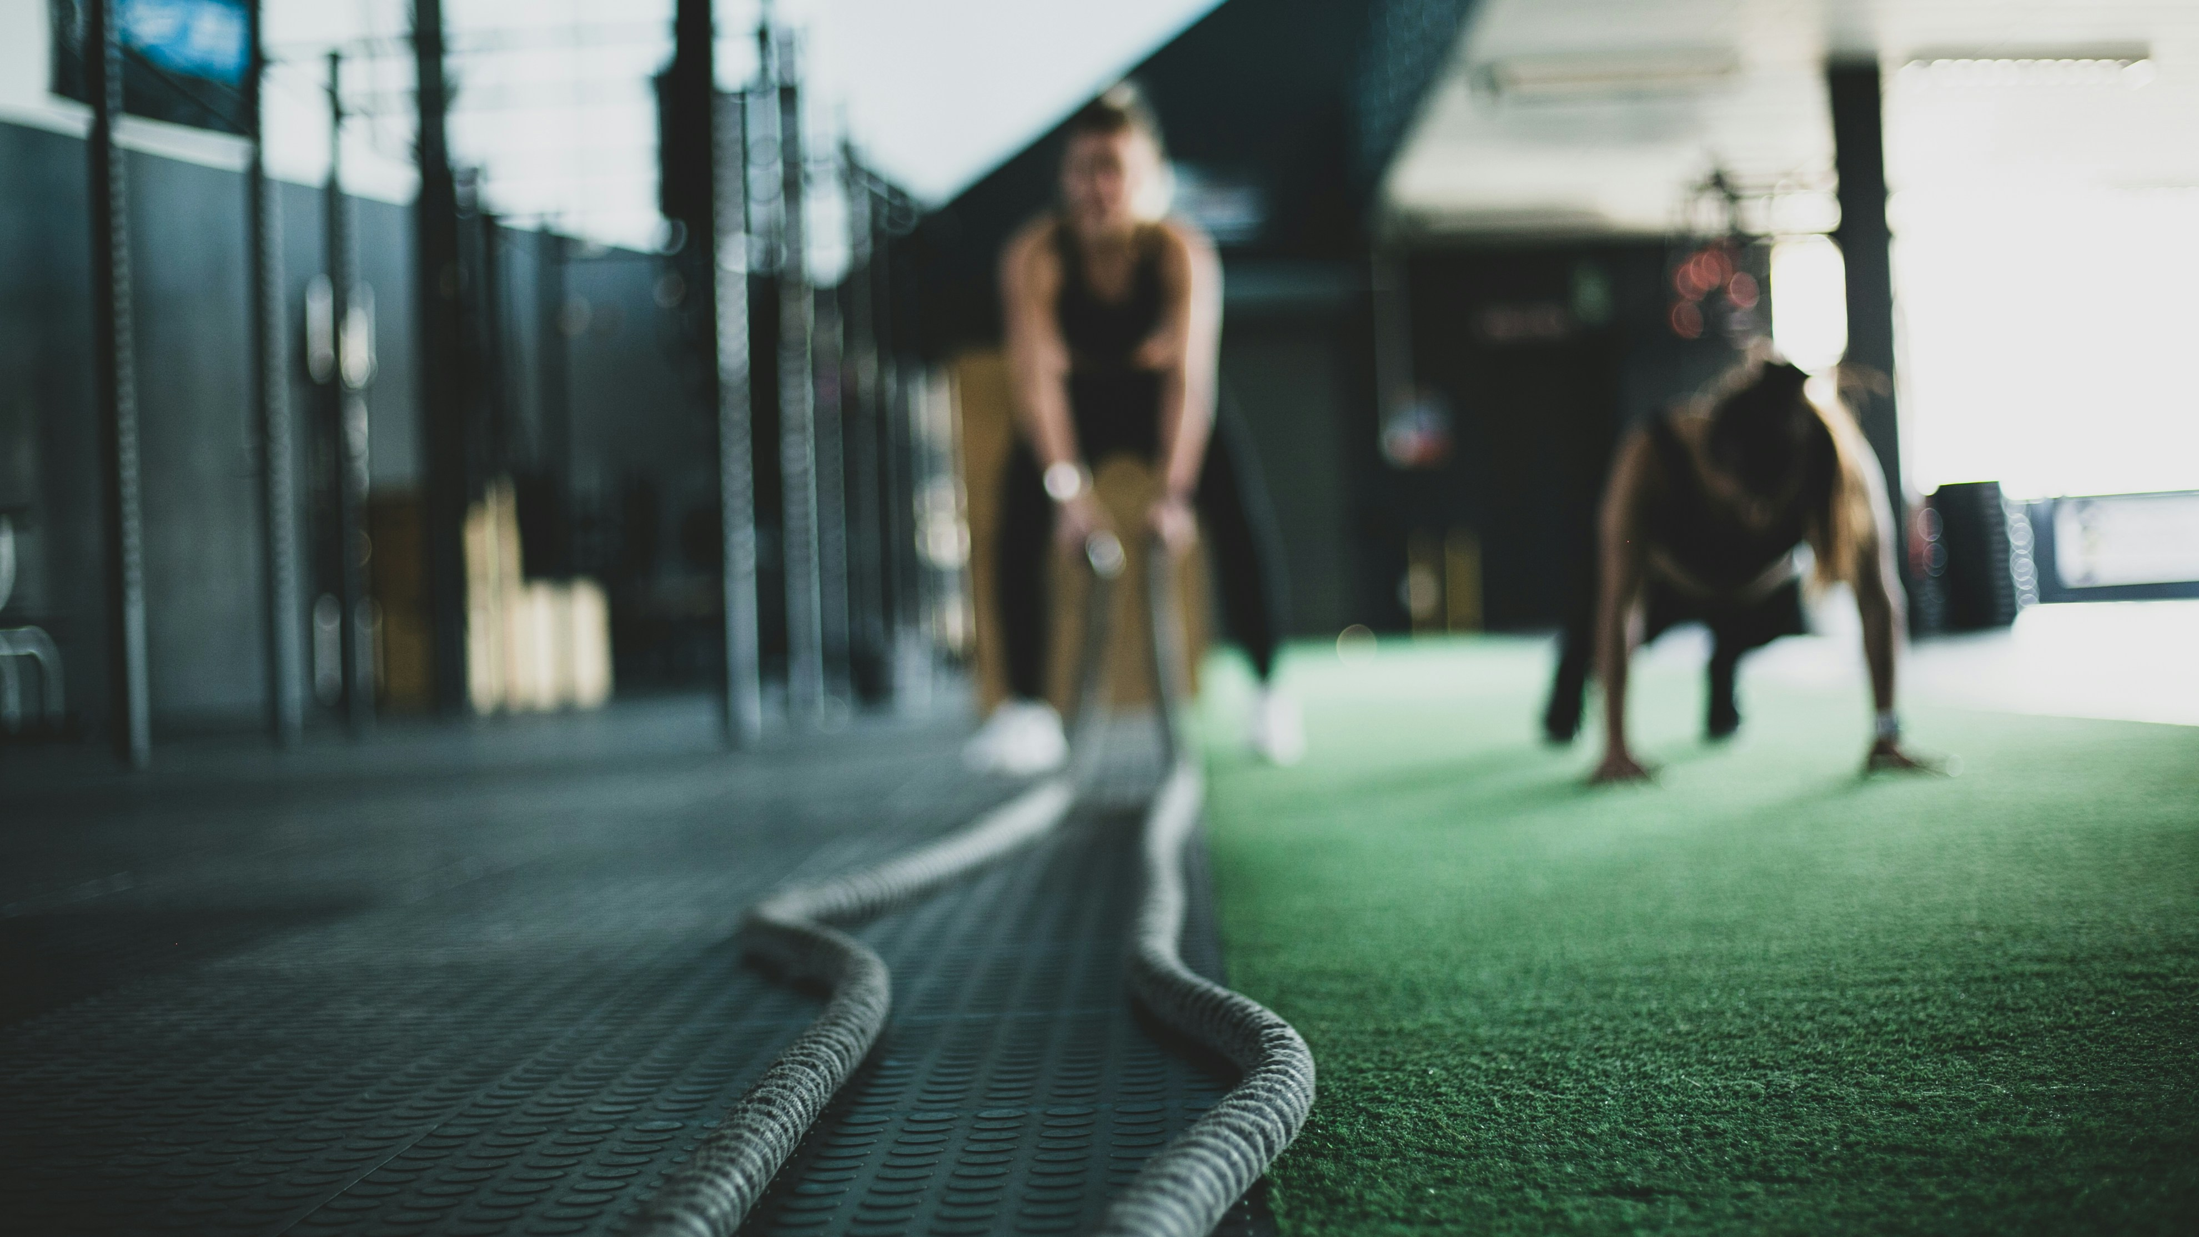
3.努力
Notes:
Training
https://unsplash.com/photos/two-person-inside-gym-exercising-buWcS7G1_28

Slide 5
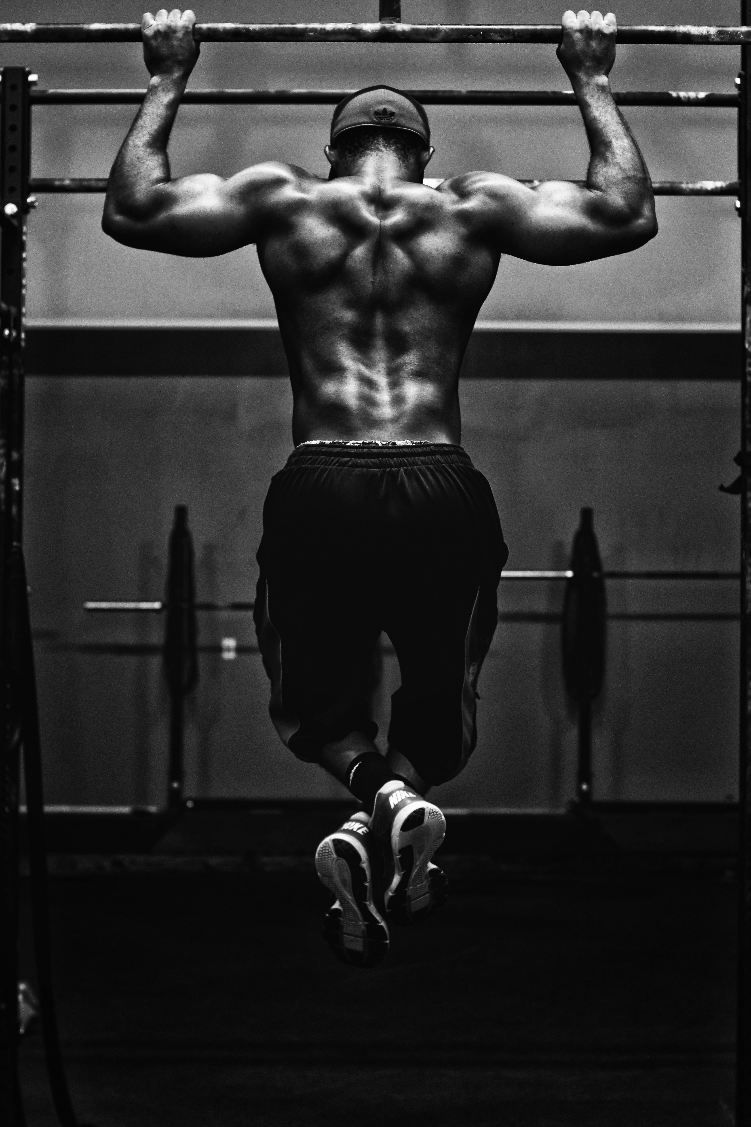
4. 結果
Notes:
教練
https://unsplash.com/photos/grayscale-photo-of-man-working-out-sHfo3WOgGTU

Slide 6
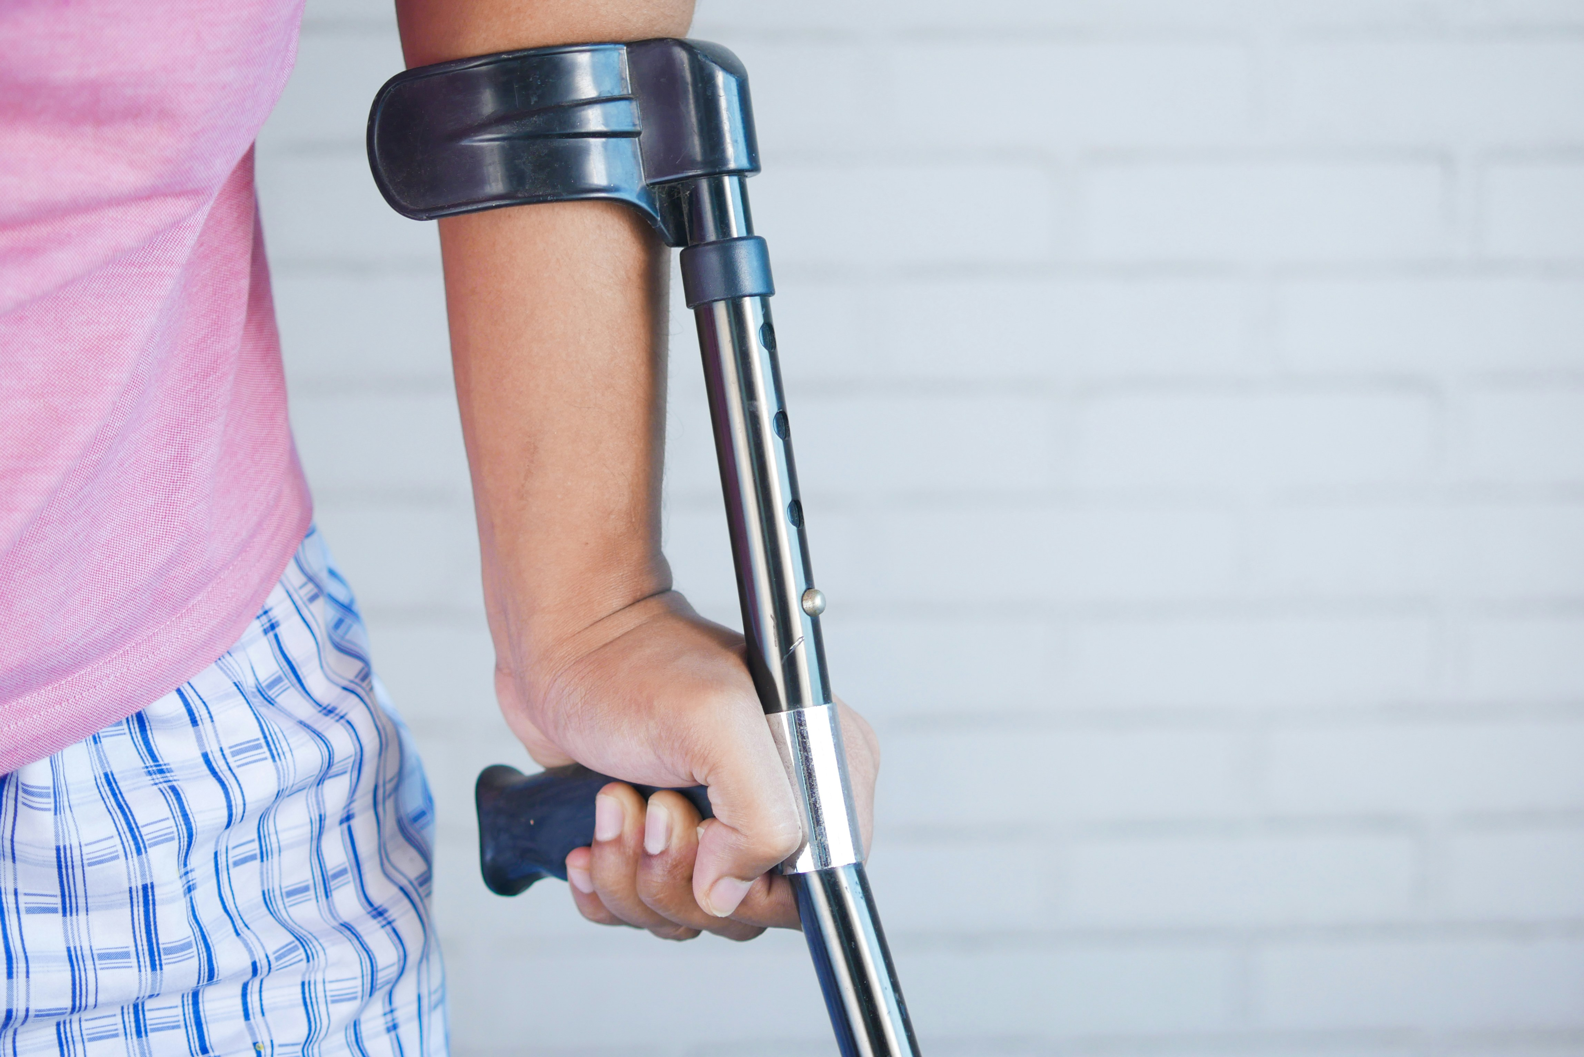
5. 意外
Notes:
Broke leg
https://unsplash.com/photos/a-person-holding-a-crutch-and-walking-cane-B3PxVCnbsSI

Slide 7

6. 轉彎
Notes:
watch
https://unsplash.com/photos/person-holding-bible-with-pen-oUiTrFhnEkE

Slide 8
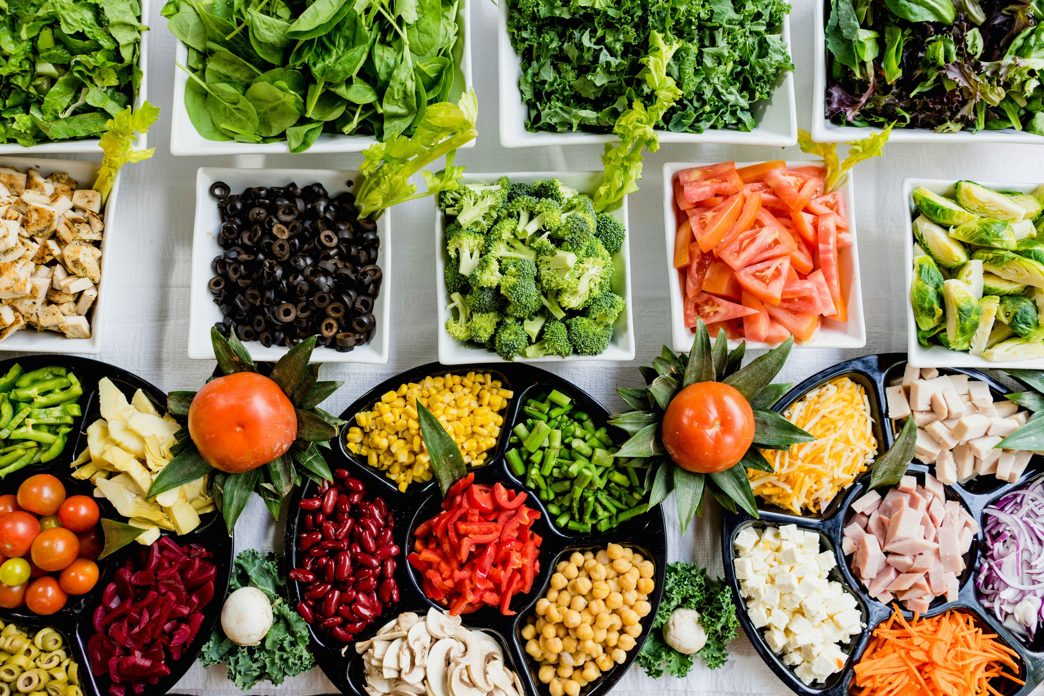
7. 結局

